Slide 1
On a Production/Inventory System with Strategic Customers and Unobservable Inventory Levels
Can Oz
Fikri Karaesmen
SMMSO 2015
3 June 2015

Slide 2
Agenda
Introduction
Model definition
Solution Procedure
Computational Study
Future Research

Slide 3
Introduction
On a Production/Inventory System with Strategic Customers and Unobservable Inventory Levels

Slide 4
Introduction
On a Production/Inventory System with Strategic Customers and Unobservable Inventory Levels
Decision-making entities
Risk neutral
Fixed reward vs. Waiting cost

Slide 5
Introduction
On a Production/Inventory System with Strategic Customers and Unobservable Inventory Levels
Inventory position of the system is not shared with the customers, only production target and service rate

Slide 6
Introduction
On a Production/Inventory System with Strategic Customers and Unobservable Inventory Levels
Fixed service rate server
Fixed payment from joining customers
vs. Inventory holding cost

Slide 7
Literature
Strategic customers in queueing systems
Naor, P. 1969
Edelson, N.M., D.K. Hildebrand 1975
Hassin, R., M. Haviv 2003
Strategic customers in make-to-stock systems

Slide 8
Model Definition
Strategic customers arrive at an inventory system that is operated by a base-stock policy
Customer’s joining decision is based on other customers’ decisions
Producer is the leader in the Stackelberg game and acts knowing customers’ decisions

Slide 9
Different versions
Customer types
  Exogenous customers vs. strategic customers
  Homogenous vs. heterogeneous customers
Demand
  Single unit vs. multiple unit
  Partial vs. full batches
Information
  Observable vs. unobservable queue length
Exit strategy
  Balking vs. staying
Service quality
  Perfect vs. stochastic service quality

Slide 10
Different versions
Customer types
  Exogenous customers vs. strategic customers
  Homogenous vs. heterogeneous customers
Demand
  Single unit vs. multiple unit
  Partial vs. full batches
Information
  Observable vs. unobservable queue length
Exit strategy
  Balking vs. staying
Service quality
  Perfect vs. stochastic service quality

Slide 11
Model Notation
Customer’s problem
  Poisson arrivals(rate λ) with unit demand
  Unobservable queue length,
  Reward for finished service, R-p
  Waiting cost per unit time, c
  May not join the system (customer’s decision)
  Will not leave the system after joining
Producer’s problem
  Exponential production time with rate μ
  Revenue per customer, p
  Holding cost per unit time, h
  No backordering or waiting cost
  Sets the production limit S (producer’s decision)
Customers and producer studied Buzacott&Shanthikumar 1993 and were very good students in stochastic models course

Slide 12
Order of Events
Customers know R, c, p and λ.
Producer announces target inventory level S and service rate μ.
Customers decide on their individual joining probability q.
Producer knew the joining probability and set S to maximize his profit.

Slide 13
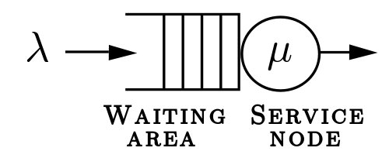


Equivalent System
M/M/1 queue
Our System

Slide 14
Useful Results
where E[W] is the expected waiting time and
E[I] is the expected inventory level
q is the joining probability
S is the production limit
Buzacott&Shanthikumar 1993

Slide 15
Customer’s Decision
Considering expected waiting time and the reward, each customer makes a decision
All customers might join the system if
Other than these cases equilibrium joining probability is unique and solves Equation (I)
From queueing counterpart we know equilibrium joining probability is 0 when

Slide 16
Customer’s Decision
Let’s assume q⁺ >q is the joining probability,
then some customers will left since their reward is negative
Similarly if q⁻ <q percent is the equilibrium joining probability then some customers will increase their joining probability

Slide 17
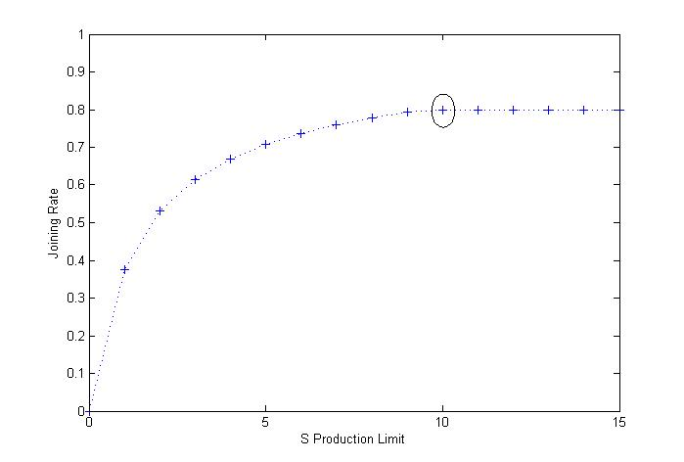
Customer’s Joining Rate

Slide 18
Equilibrium Joining Probability
q_{S} is a non-decreasing function of S
After a threshold level joining probability is 1

Slide 19
Producer’s Problem
Tries to maximize his profit by setting the inventory target S
where the expected inventory level is
Producer’s decision set is bounded

Slide 20
Producer’s Problem
Step 1:Set S = 0, calculate the equilibrium joining rate and resulting profit for the producer
Step 2: If q_{S} ≠ 0, set S = S+1 go to Step 1
else go to Step 3
Step 3: Find the maximizer of the expected profit among the calculated

Slide 21
Social Optimization
Tries to maximize total system profit by deciding on arrival rate λ and inventory target S
For fixed λ, optimal S is the solution of Equation (II) (Buzacott&Shanthikumar 1993)

Slide 22
Computational Study
p ~ DU[1,20] and λ ~ CU[0,0.97]
Lower profitability R/c=2 vs higher profitability R/c=10
Customer’s willingness to join is increasing
Setting | Low R/c | High R/c | R/c<p/h | R/c=p/h | R/c>p/h
h | pCU[0,1] | pCU[0,1]/5 | pCU[0,1]/5 | pCU[0,1]/5 | pCU[0,1]/5
R | p+DU[1,20] | p+DU[1,20] | p+DU[1,10] | p+DU[1,20] | p+DU[1,40]
c | RCU[0,1] | RCU[0,1]/5 | RCU[0,1]/5 | RCU[0,1]/5 | RCU[0,1]/5

Slide 23
Joining rate comparison

Slide 24
Target inventory level comp.

Slide 25
Profit comparison
Notes:
When is low, 39% of instances are of this type. And when is high, the percentages are 12%, 5% and 3% for , and , respectively. We see a decreasing trend in the occurrence of these instances as increases

Slide 26
Profit comparison cont’d
Metric | Low R/c | R/c<p/h | R/c=p/h | R/c>p/h
T(λ_{D},S_{D})/ T(λ_{C},S_{C}) | 0.72 | 0.91 | 0.85 | 0.79
Π(λ_{D},S_{D})/ Π(λ_{C},S_{C}) | 1.10 | 0.97 | 0.9 | 0.83
θ(λ_{D},S_{D})/ θ (λ_{C},S_{C}) | 1.23 | 1.14 | 1.3 | 1.54
% of instances customer loss | 39 | 12 | 5 | 3

Slide 27
Conclusion
Developed a make-to-stock production system with strategic customers
Characterized customers’ equilibrium joining probability and producer’s optimal decision
Identified cases where centralization is profitable

Slide 28
Future Research
Fully observable system
  Finished the analysis of centralized and decentralized problems
  Showed the concavity of producer’s profit function
  Showed the optimality of base stock policy and
Partially observable system
Comparison with pure queueing system

